Slide 1

Analyzing Arrival Through the Lens of NLP
SM Tawhid

Slide 2
Overview of the Film
Arrival (2016) centers on a linguist, Dr. Louise Banks, who is recruited to decipher the language of alien visitors.
The film explores how communication can shape thought, reality, and even time.
Central theme: Bridging a vast linguistic gap between humans and an entirely non-human intelligence.

Slide 3

NLP Challenges in the Movie
Ambiguity: Logograms like 'weapon' can be misinterpreted.
Context: Meanings depend on the full sentence/symbol context.
Idioms/Culture: Aliens don’t understand human idiomatic expressions.
Sarcasm/Irony: Not translatable in a literal sense.
Sequence matters: Heptapods communicate whole thoughts at once.

Slide 4
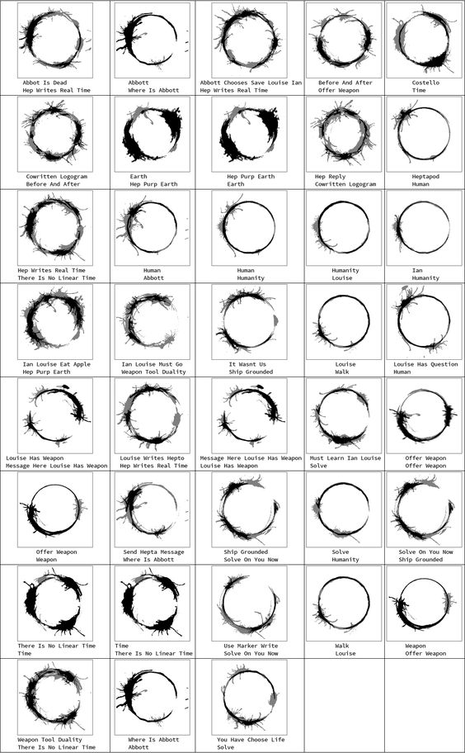
NLP Concepts Reflected in Arrival
Tokenization: Louise starts with simple words to build understanding.
Stop Words: Filtering unimportant words to extract meaning.
Embeddings: Logograms mapped in a visual feature space.
Ambiguity Resolution: Similar to multi-step reasoning in NLP.

Slide 5
Communication Methods vs NLP
Rule-based logic → Rule-based NLP
Pattern recognition → Statistical NLP
Learning through exposure → Deep NLP (RNNs/LSTMs)
Symbol segmentation → Tokenization
Context building → Sequence Modeling

Slide 6

Where RNNs Fit
RNNs are designed for sequential data, like language.
Louise learns from sequences just like RNNs build meaning from prior steps.
Looped memory in RNN = Learning from prior context.
Heptapod language structure challenges even advanced models.

Slide 7
Reflection: NLP Lessons from Arrival
Language shapes how we think.
Sequence modeling is essential for understanding.
NLP must go beyond syntax to inference and semantics.
Arrival suggests language is not always linear.

Slide 8

Final Takeaways
Arrival mirrors real NLP problems: ambiguity, context, culture.
Communication is deeply sequence-dependent.
RNNs and Transformers help, but meaning is the real challenge.
Future NLP should model thought, not just words.

Slide 9
References
Arrival (2016), dir. Denis Villeneuve
ITAI 2376 Module 05 – Sequence Modeling
Jurafsky & Martin, Speech and Language Processing

